Slide 1
Rowan Belden
INFO 3100 Final Assignment

Slide 2
The way my python output box is formatted it would not allow me to take a screenshot of the full graph, so I had to splice two screenshots together. I apologize for the inconvenience.

Slide 3
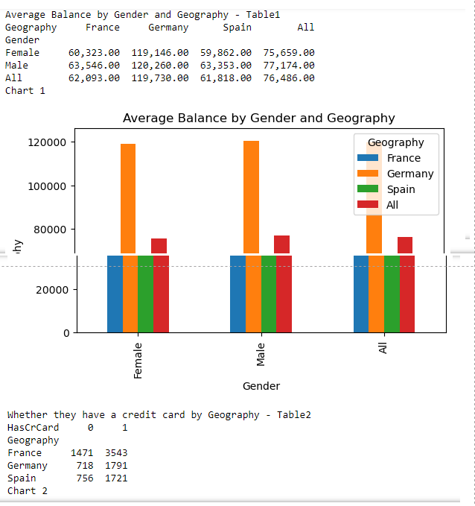
Task 1 – Pivot Tables
Average Balance by Gender and Geography
Customer Churn
Vertical Bar Graph

Slide 4
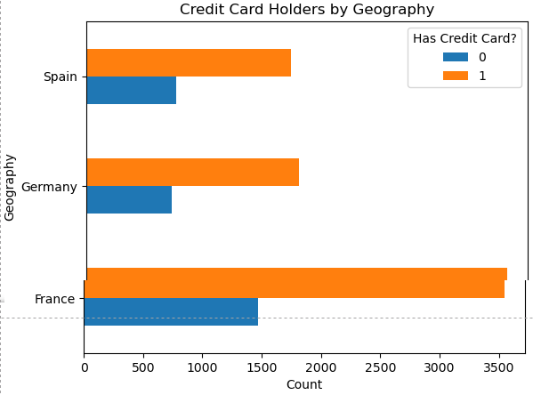
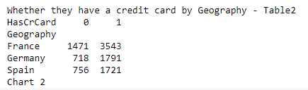
Task 1 – Pivot Tables & Cross Tabs
If they have a credit card by Geography
Customer Churn
Horizontal Bar Graph

Slide 5
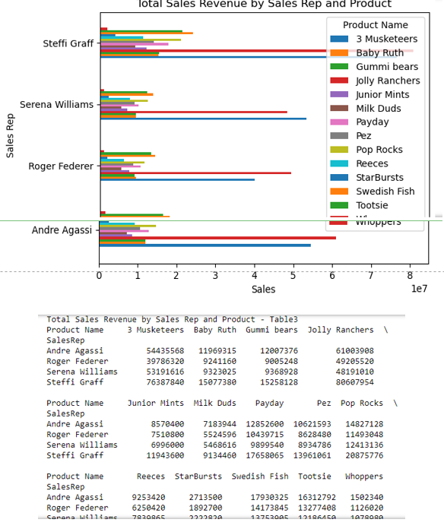
Task 1 – Pivot Tables and Cross Tabs
Total Sales Revenue By Sales Rep and Product
Tennis Greats
Horizontal Clustered Bar Graph

Slide 6
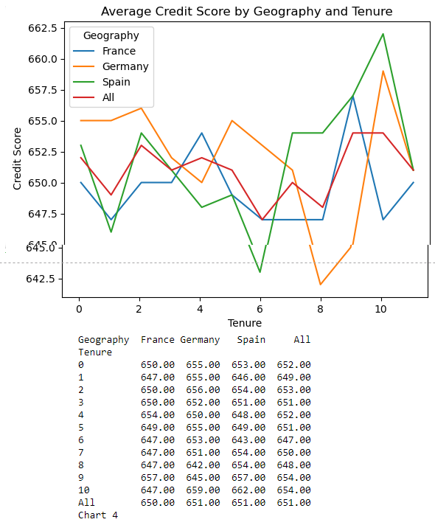
Task 1 – Pivot Tables and Cross Tabs
Average Credit Score by Geography and Tenure
Customer Churn
Line Graph

Slide 7
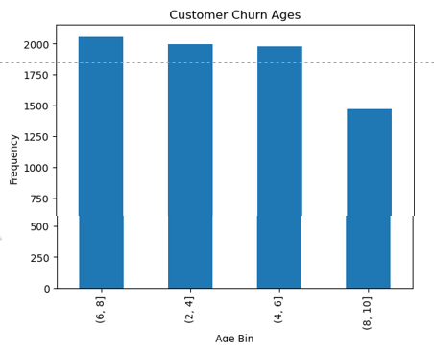
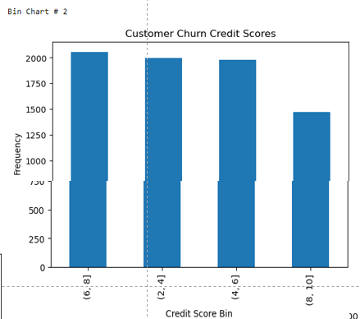
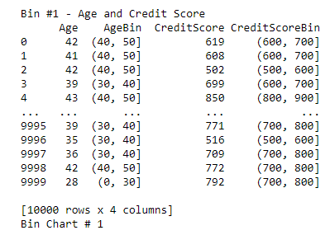
Task 2 – Binning
A bin of Ages and Credit Scores
Customer Churn
Graphed Separately, into Histograms

Slide 8
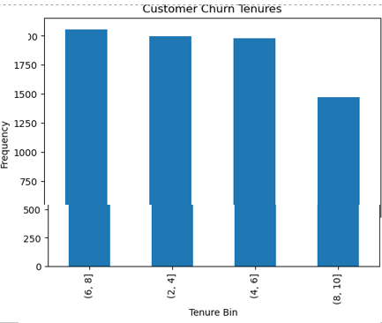
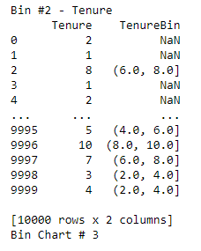
Task 2 – Binning
A bin of Tenures
Customer Churn
Graphed into a Histogram

Slide 9
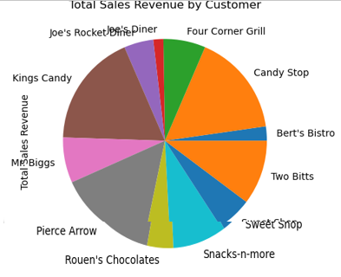
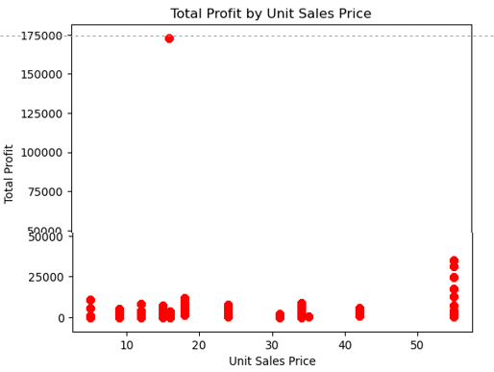
Task 3 – Charts
Graph 1: Total Sales Revenue By Customer
Tennis Greats
Pie Chart
Graph 2: Total Profit By Unit Sales Price
Tennis Greats
Scatter Plot

Slide 10
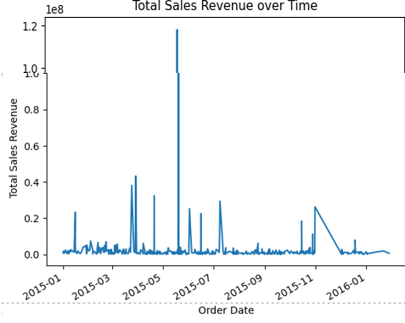
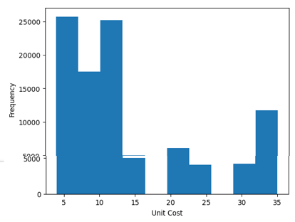
Task 3 – Charts
Graph 1: Total Sales Revenue Over Time
Tennis Greats
Line Chart
Graph 2: Unit Cost, 10 bins
Tennis Greats
Histogram

Slide 11

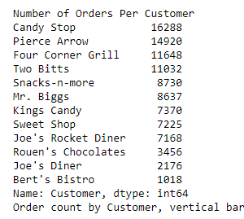
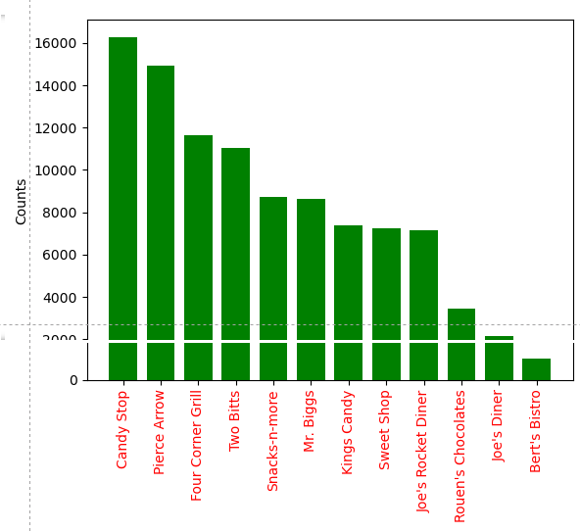
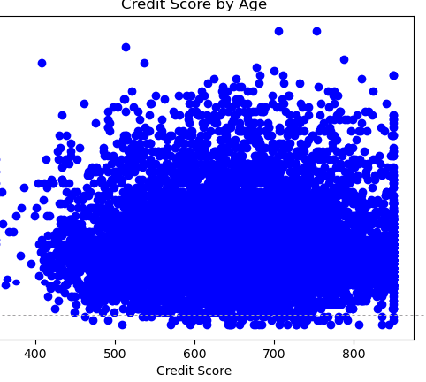
Task 3 – Charts
Graph 1: Number of Orders Per Customer
Tennis Greats
Vertical Bar Chart
Graph 2: Credit Score By Age
Customer Churn
Scatter Plot

Slide 12
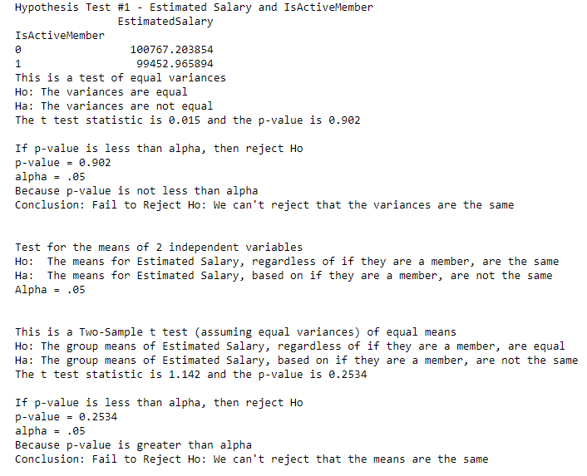
Task 4 – Hypothesis
Hypothesis results P-value: .902, .2534 Accept Ho
the results of a test of the assumption that the variances of active members and non-active members are equal. the p-value for this test is 0.902, which is greater than alpha level. Therefore, we cannot reject the null hypothesis and must conclude that the variances are not significantly different.
The null hypothesis (Ho) for this test is that the means of the estimated salary for both active and non-active members are equal. the p-value for this test is 0.2534, greater than alpha and thus we cannot reject the null hypothesis and must conclude that there is not a statistically significant difference.

Slide 13
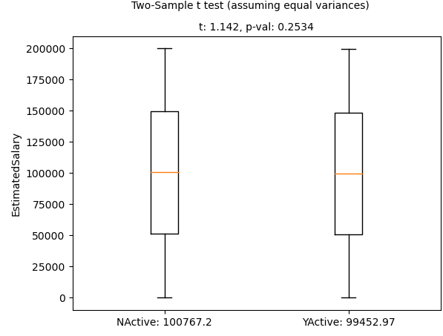

Slide 14
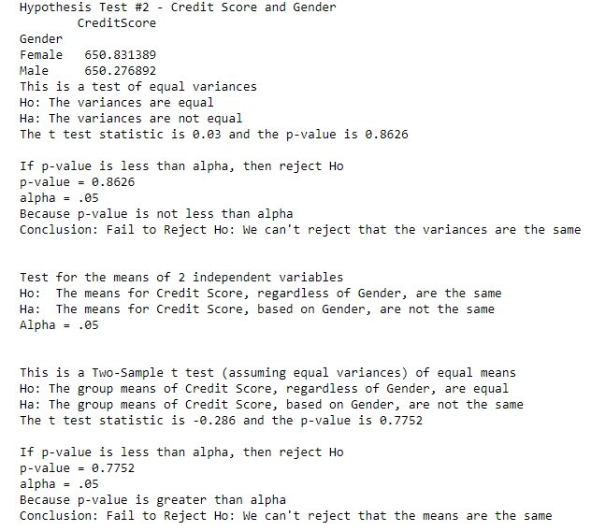
Task 4 – Hypothesis
Hypothesis results P-value: .8626, .7752 Accept Ho
Test of the assumption that the variances of male and female customers are equal. The null hypothesis (Ho) is that the variances are equal. The P-Value is 0.8626, which is greater than the alpha and so we cannot reject the null hypothesis and must conclude that the variances are not significantly different.
Next is a two-sample t-test assuming equal variances. The null hypothesis (Ho) is that the means of the credit score for both male and female customers are equal. The P-Value is 0.7752 and so we cannot reject the null hypothesis and must conclude that there is not a statistically significant difference in the credit score of male and female customers.

Slide 15
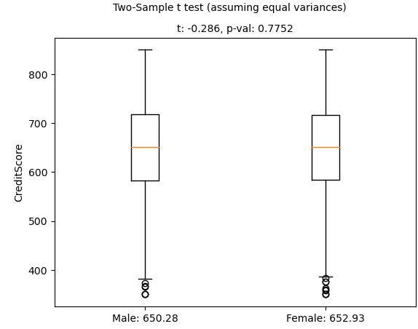

Slide 16
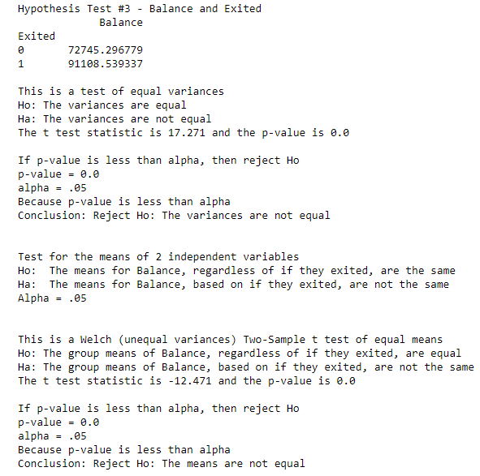
Task 4 – Hypothesis
Hypothesis results P-value: 0, 0 Reject Ho
The first part of the test is a test of equal variances between exited customers and present customers. The null hypothesis (Ho) is that the variances of the two groups are equal. The test statistic is 17.271, and the p-value is 0.0. P-value is less than the significance level of 0.05, we reject Ho and conclude that the variances of the two groups are not equal.
The next test is a two-sample t-test of equal means. Because the P-Value is zero and less than the significance level, we can reject the Ho and the balance of customers who have exited the bank is significantly different from those who have not.

Slide 17
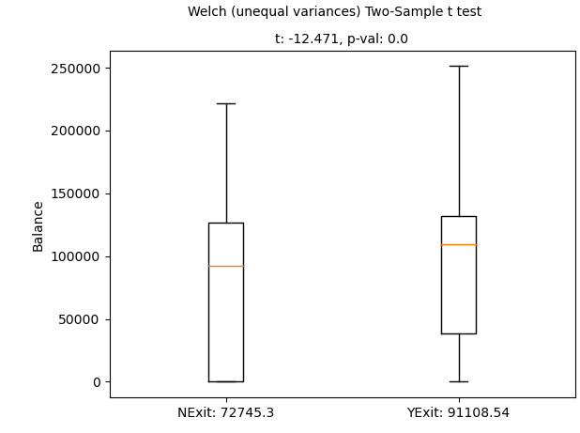

Slide 18
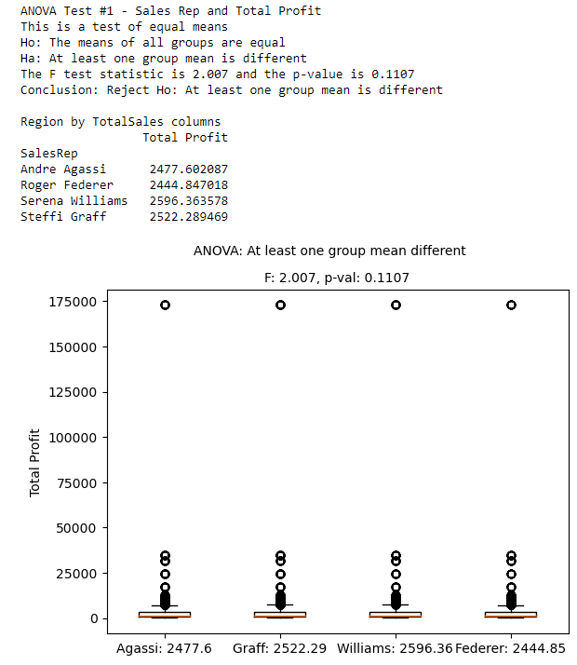
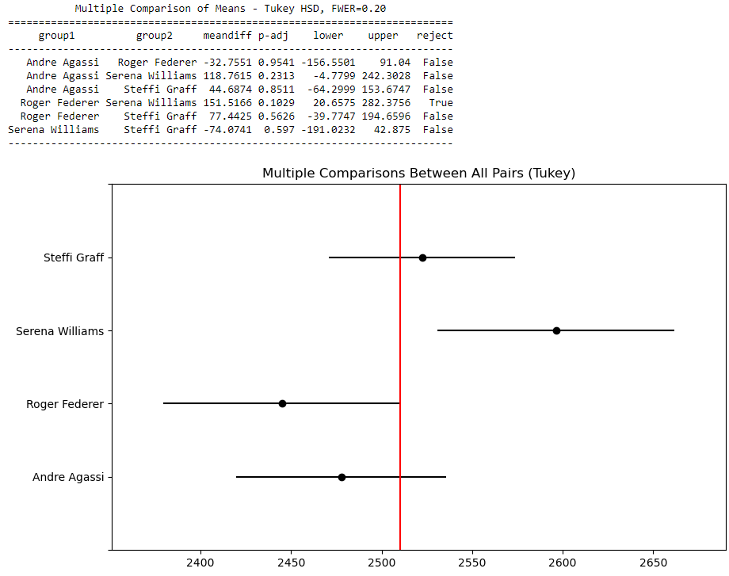
Task 5 – ANOVA
ANOVA results The F test statistic is 2.007 and the p-value is 0.1107. Therefore, we can Reject the Ho as at least one group mean is different.
Only the comparison between Roger Federer and Serena Williams has a p-value less than alpha (0.05), indicating that there is a significant difference in means between these two groups and we cannot reject the null hypothesis

Slide 19
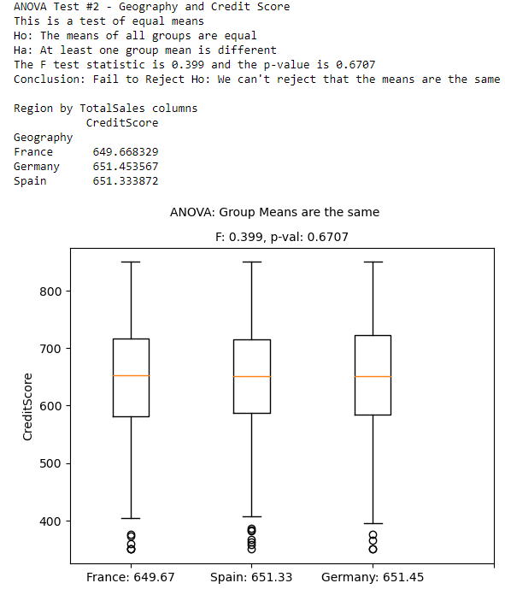
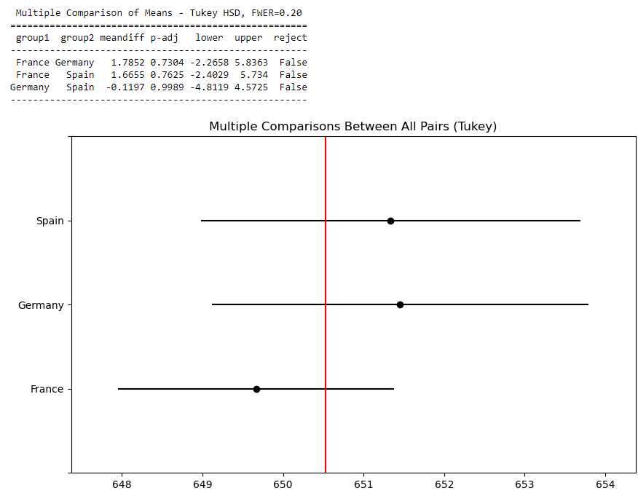
Task 5 – ANOVA
ANOVA results F test statistic is 0.399 and the p-value is 0.6707. We cannot reject the null hypothesis
The P-Value is greater than the significance level
No statistically significant difference in credit scores across the different geographies.

Slide 20
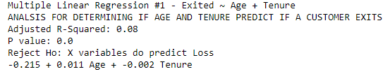
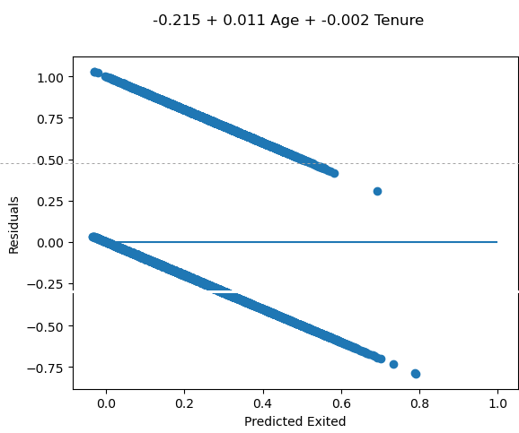
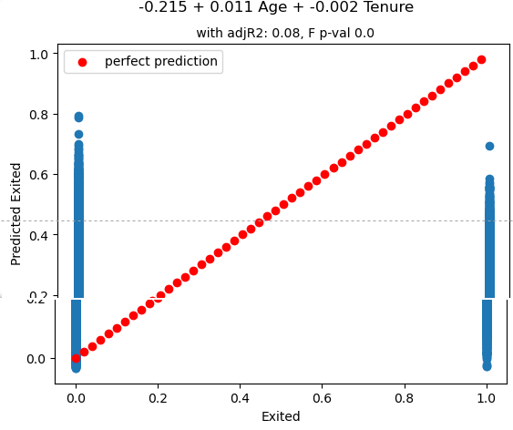
Task 6 – Multiple Linear Regression
Multiple Linear Regression results
P-Value = 0, Adjusted R-Squared = .08
Age and Tenure have little effect on the variation of Exited
The P-Value suggests the data is statistically significant
Other important factors excluded as evident by the R-Squared

Slide 21
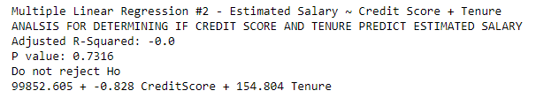
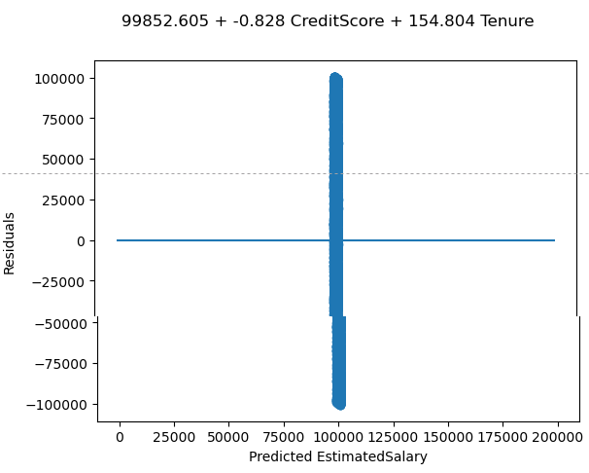
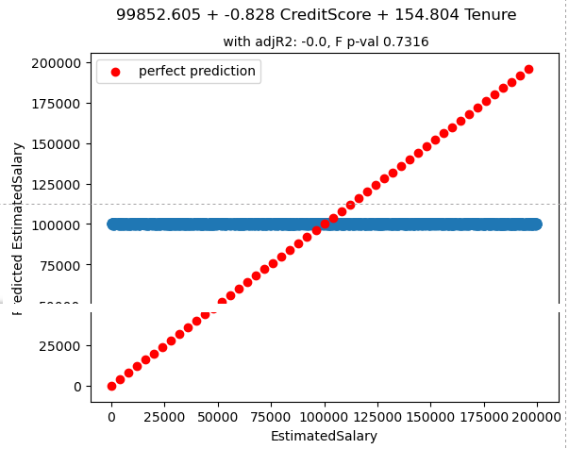
Task 6 – Multiple Linear Regression
Multiple Linear Regression results
P-Value = .7316, Adjusted R-Squared = 0.0
Credit Score and Tenure have no effect on the variation of Estimated Salary based on the Adjusted R-Squared
The P-Value is greater than significance score, so we fail to reject null Ho

Slide 22
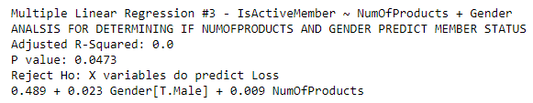
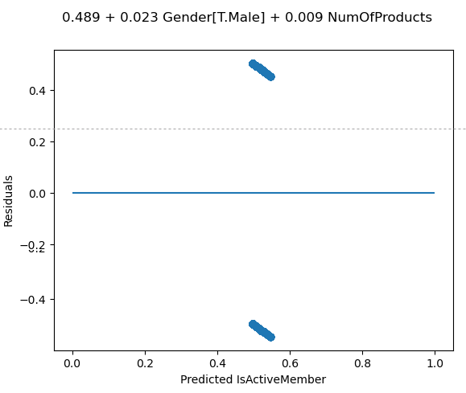
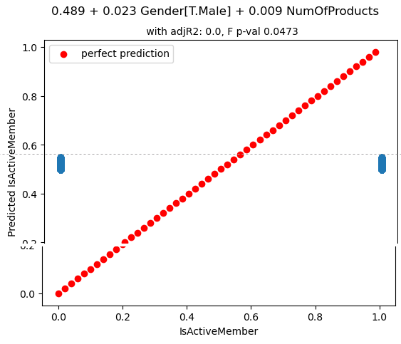
Task 6 – Multiple Linear Regression
Multiple Linear Regression results
P-Value = .0473, Adjusted R-Squared = 0.0
Gender and Number of Products have no effect on the variation of Estimated Salary based on the Adjusted R-Squared
The P-Value is less than significance score (.05), so we reject the null Ho, and the predictors are valid for Estimated Salary

